Slide 1
Polymers & Crystals

Slide 2
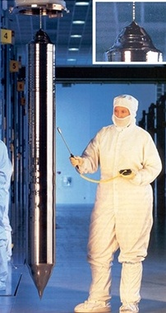
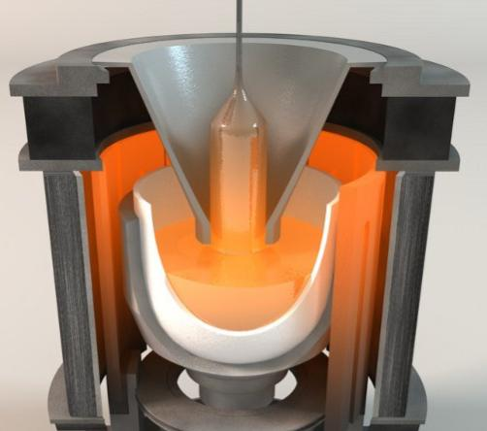
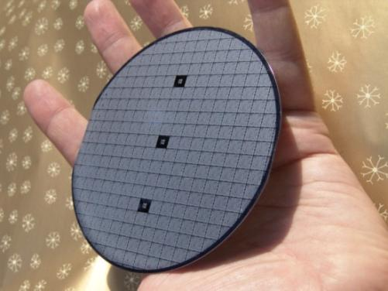
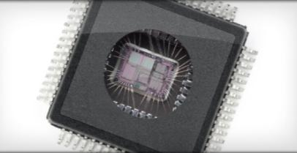
Computer & Electronic Industry: All electronic devices incorporate integrated circuits (sometimes called computer chips). The chips are cut from silicon crystals. One large silicon crystal is grown by placing a spinning rod with a silicon seed crystal into a crucible of molten silicon. Silicon atoms in the molten silicon start to attach themselves to the crystal which makes the crystal grow.
The rod is slowly pulled away and one large crystal of silicon is formed in a cylindrical shape.
The cylindrical crystal is sliced into wafers and then etched with thousands to millions of transistor based circuits within squares.
These squares are cut and become microchips. Small gold wires are soldered to them and they’re encased in plastic.
Silicon Crystals

Slide 3
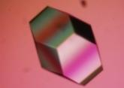
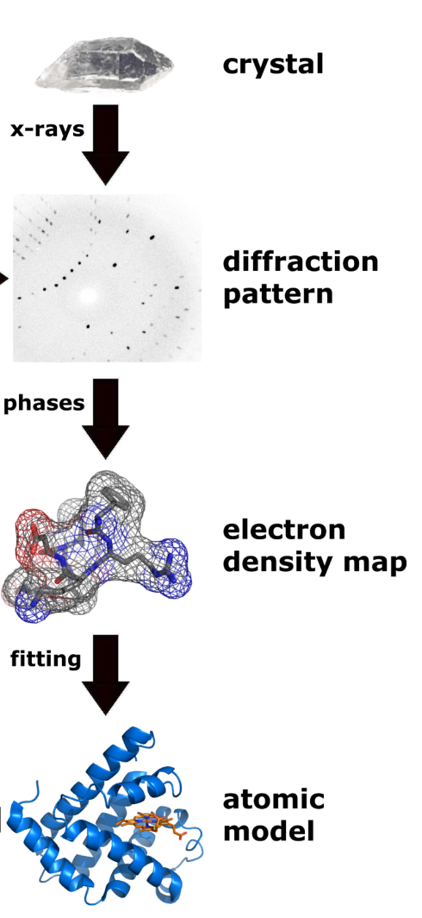
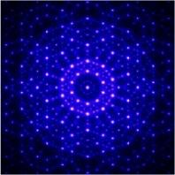
X-ray Crystallography:
To determine the molecular structure of molecules like proteins, DNA, and minerals, a crystal of that substance is first grown and then subjected to x-rays that will be scattered by the electrons in in the molecule.
The scattering causes a “diffraction pattern” when scattered x-ray waves interfere with each other. From the diffraction pattern, calculations can create an electron density map, which can then lead to the actual structure (atomic model) of the molecule. A protein molecule is shown in the illustration.

Slide 4
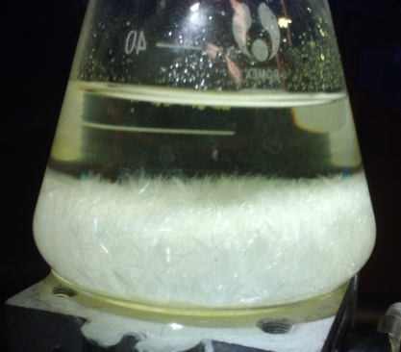
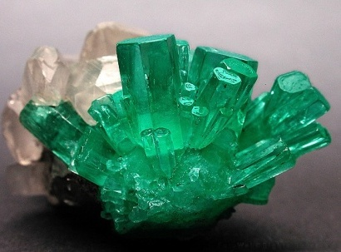
Mercury Nitrate crystals
Purification by Crystallization:
Many water soluble substances can be purified by dissolving them in water and then letting the water either cool or evaporate until the dissolved substance turns into crystals.
In nature, some gemstones form in this manner in areas of high pressure and high temperature (emeralds are one example). Medicine, drugs and other substances can be purified in the same way but at lower temperatures and pressures. In both cases a seed crystal will speed up the process.
Emeralds

Slide 5
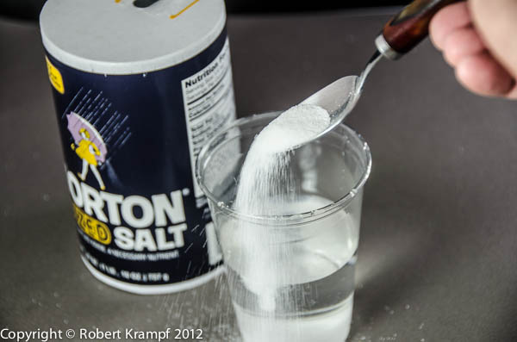
Lab 7: Crystals & Polymers: Growing Crystals
When a substance stops dissolving in water, then the solution is said to be saturated.
If water evaporates from that solution or the solution is cooled, the solution will become supersaturated. At that point some of the substance will turn into a solid. In some cases that solid will be a crystal.

Slide 6
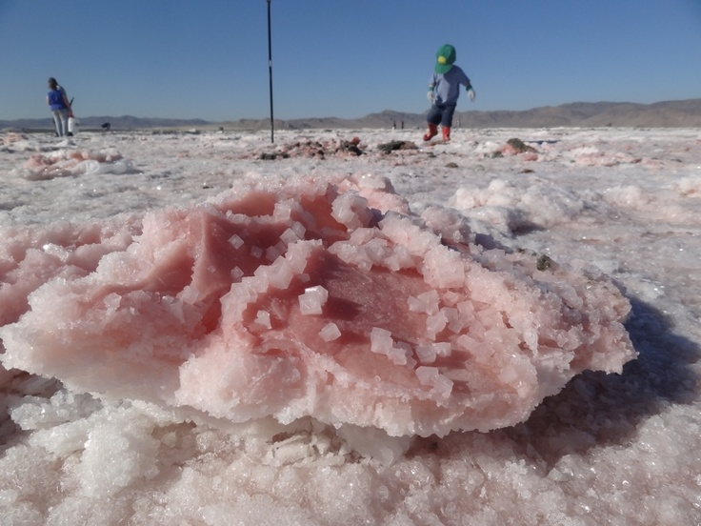

Slide 7
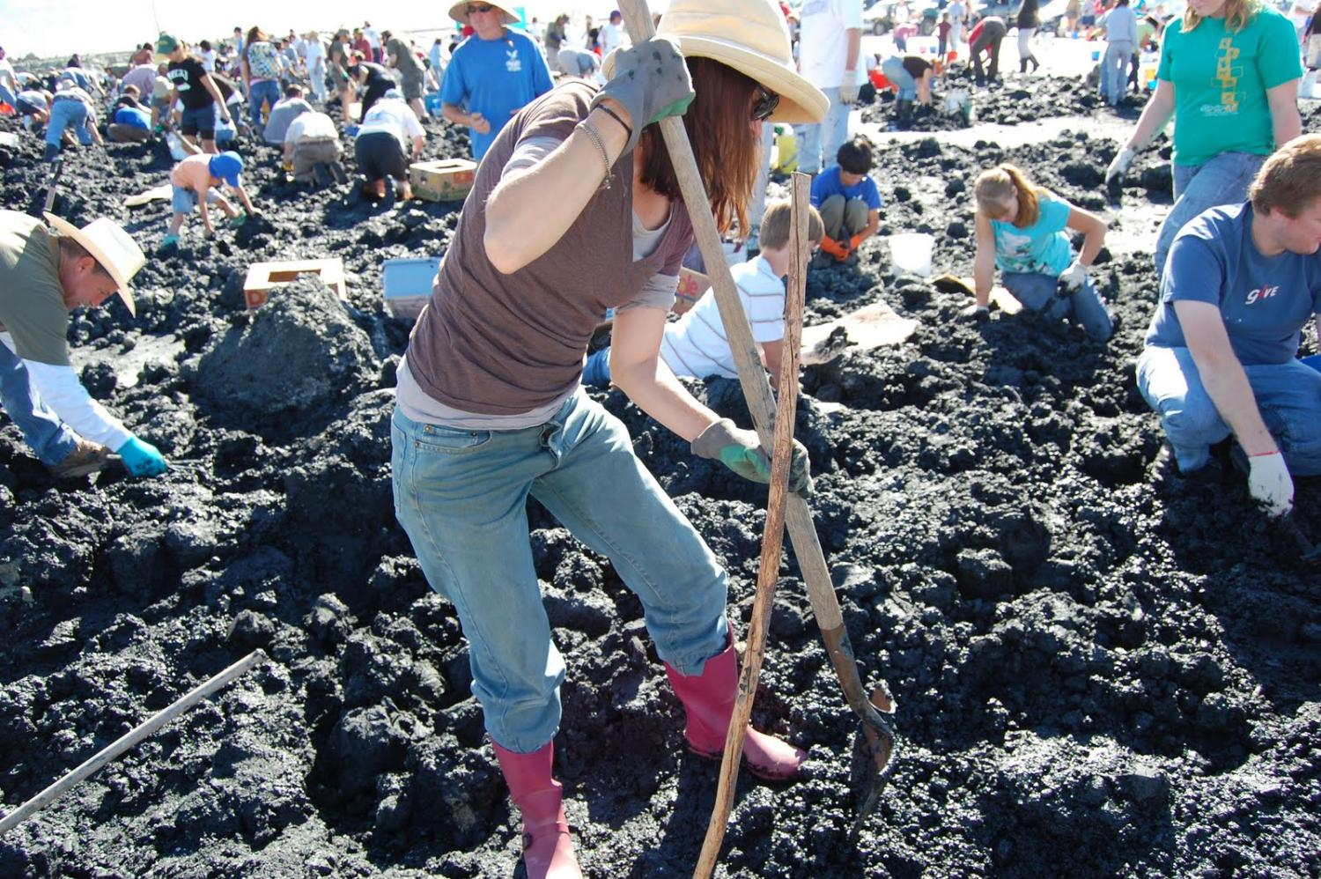

Slide 8
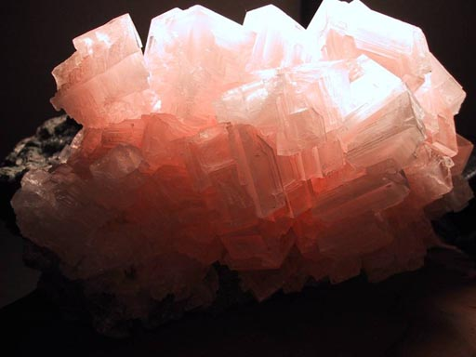

Slide 9
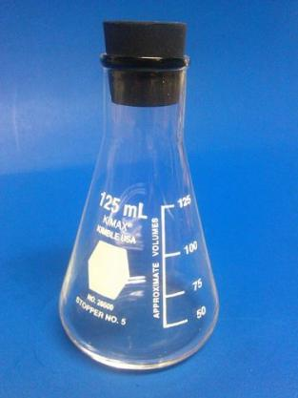
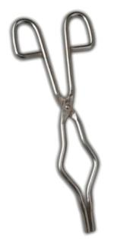
Lab 7: Crystals & Polymers: Growing Crystals
Create saturated solution of borax.
Weigh out 1.25 grams of borax. Place it in 125 mL Erlenmeyer flask. Add 50 mL of distilled water. Stir to dissolve. If it doesn’t dissolve place it on a hot plate that is set to Low. Warm it to 50°C if need be to help dissolve. Stir regularly with glass or plastic rod.
After all (or most) of the borax is dissolved, use crucible tongs to pick up the Erlenmeyer flask and set on counter to cool.
Create saturated solution of alum
Weigh out 10.0 grams of alum. Place it in 125 mL Erlenmeyer flask. Add 50 mL of distilled water. Stir to dissolve. If it doesn’t dissolve place it on a hot plate that is set to Low. Warm it to 50°C if need be to help dissolve. Stir regularly with glass or plastic rod. After all (or most) of the alum is dissolved, pick up the Erlenmeyer flask with crucible tongs and set on counter to cool.

Slide 10
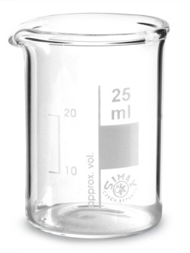
Wrap a wooden splint (or Q-tip stick) with about 3 inches of copper thread with 1 inch of the copper thread hanging below the top of the beaker. The copper wire will hopefully be the site where the crystal grows. Cover the top of the beaker with a paper towel or a watch glass.

Slide 11
Lab 7: Crystals & Polymers: Cross-linking polymers
Slime: Slime was made famous by the Ghostbuster movies. Slime is made of two components. One is a polymer that dissolves in water. It’s called polyvinyl alcohol.
Oxygen
H
H
H
O
O
C
C
C
C
H
H
C
C
C
C
H
H
H
H
H
H
Vinyl
Vinyl alcohol
Vinyl alcohol
Ethylene
Polyvinyl alcohol
H
H
H
H
H
H
H
H
H
O
H
O
H
O
H
O
H
O
H
O
H
O
H
O
C
C
C
C
C
C
C
C
C
C
C
C
C
C
C
C
H
H
H
H
H
H
H
H
H
H
H
H
H
H
H
H

Slide 12
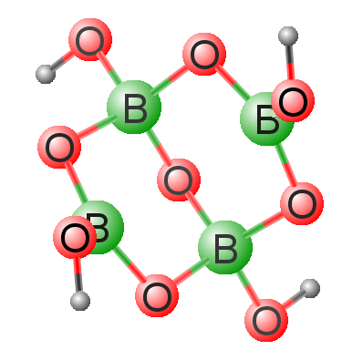
Cross-linking using Borax
boron
2-
Na⁺
H
O
H
O
B
O
B
O
O
O
Na⁺
B
B
O
O
O
H
H
Sodium borate (borax) Na₂B₄O₅(OH)₄

Slide 13
Polyvinyl chloride dissolves in water and has a viscosity similar to milk; however, when mixed with borax, the solution turns into a gel (slime) quickly. The borate ion has oxygen atoms that are attracted to the hydrogen atoms on the polyvinyl chain (dotted lines). Borate also has hydrogen atoms attracted to the oxygen atoms on the polyvinyl chain. This cross-links the two chains together, which reduces the movement of the polyvinyl chains. So the solution gets much thicker (higher viscosity).
H
H
H
H
H
H
H
H
H
O
H
O
H
O
H
O
H
O
H
O
H
O
H
O
C
C
C
C
C
C
C
C
C
C
C
C
C
C
C
C
H
H
H
H
H
H
H
H
H
H
H
H
H
H
H
H
H
O
H
2-
B
O
B
O
O
O
O
B
B
O
O
O
H
H
Na⁺
Na⁺
H
H
H
H
H
H
H
H
H
O
H
O
H
O
H
O
H
O
H
O
H
O
H
O
C
C
C
C
C
C
C
C
C
C
C
C
C
C
C
C
H
H
H
H
H
H
H
H
H
H
H
H
H
H
H
H

Slide 14
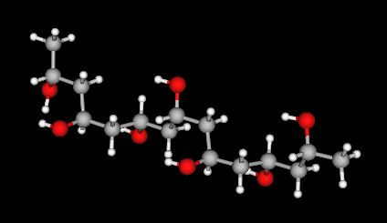
Polyvinyl alcohol charge map

Slide 15
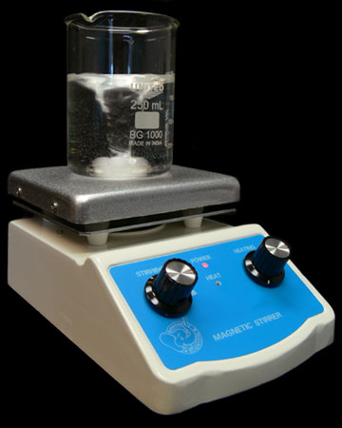
Make 4% w/v polyvinyl solution: Measure 100 mL of distilled water and place into a 250 mL beaker. Weigh out 4 grams of polyvinyl alcohol and add it to beaker. If it doesn’t want to dissolve, place beaker on stirring hot plate and bring temperature up to 60° Celsius. Once all or most of the polyvinyl alcohol dissolves, turn off hot plate and let solution cool. If you want, you can add a drop of food coloring to the solution to give it a color.
100 mL is enough for about 4 groups.

Slide 16
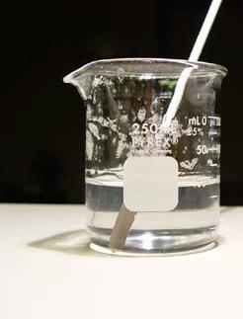
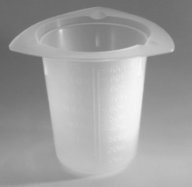
Make 4% w/v borax solution: Measure 100 mL of distilled water and place into a 100 mL plastic beaker (in your lab drawer). Weigh out 4 grams of borax and add it to the plastic cup. It should dissolve easily, so just stir with glass rod or plastic rod.
100 mL of 4% w/v polyvinyl alcohol solution
100 mL of 4% w/v polyvinyl alcohol solution

Slide 17
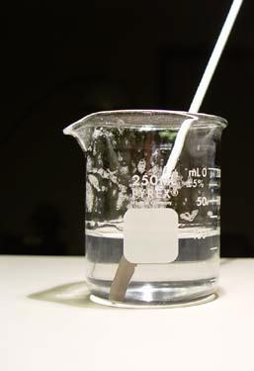
100 mL of 4% w/v polyvinyl alcohol solution
100 mL of 4% w/v polyvinyl alcohol solution
Decide how much borax solution to add: According to the literature, slime can be made by adding borax solution that is from 1/20 to 1/2 the volume of the polyvinyl solution. Since we have 100mL of polyvinyl solution, 1/20 of that is 5mL and 1/2 of that is 50mL. 5mL of the borax solution would make it slimy and runny; 50mL should make it stiff like a rubber ball. 25mL of borax solution has been successful, but you can try a different amount of borax solution.

Slide 18
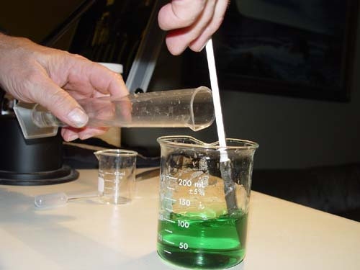
Here 25 mL of borax solution was added to the 100 mL of 4% w/v polyvinyl alcohol solution. As soon as the borax is poured in, stir with the plastic stirring rod.

Slide 19
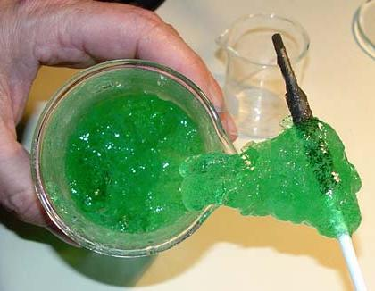
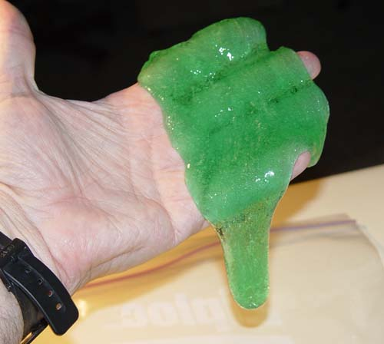
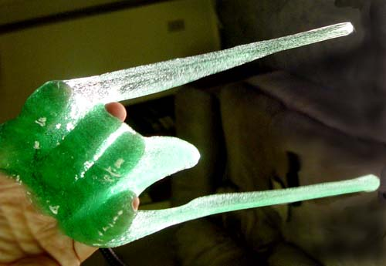

Slide 20
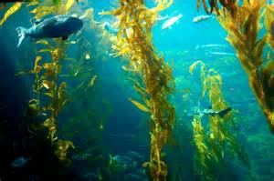
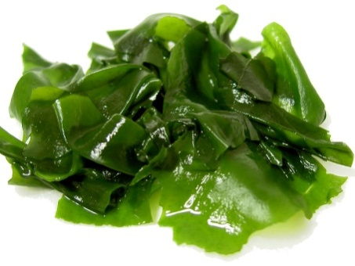
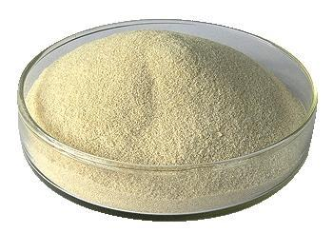
Lab 7: Crystals & Polymers: Cross-linking for Spherification
Seaweed
Alginic acid
Kelp Seaweed
Seaweed as Natural Resource: Seaweed is collected around the world and one product extracted from the walls of the plant is alginic acid, which is similar to cellulose. Both are made from chains of sugar molecules. Alginic acid is neutralized with sodium hydroxide (NaOH), which converts alginic acid to water soluble sodium alginate.

Slide 21
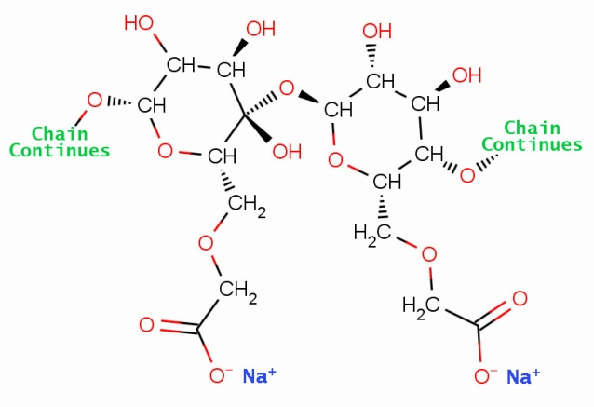
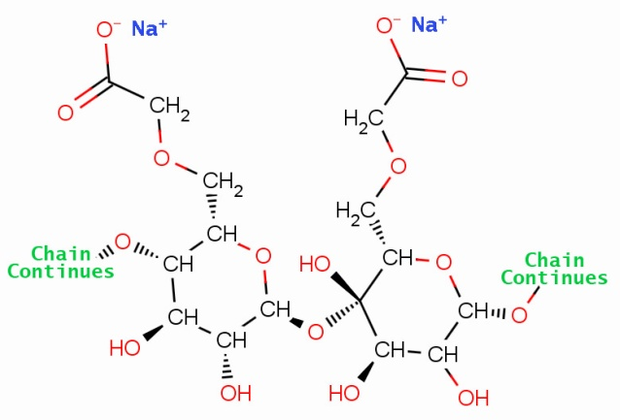
Sodium Alginate chain
When a solution of sodium alginate is mixed with a solution containing calcium ions, the calcium ions cross-links the alginate chains, which causes them to no longer be soluble.
Ca²⁺
Calcium ion pulls on the negative oxygen atoms
Another Sodium Alginate chain

Slide 22
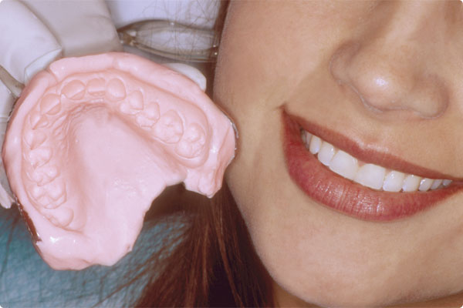
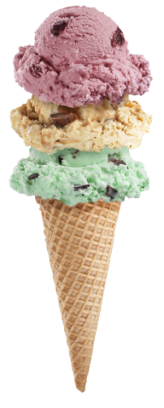
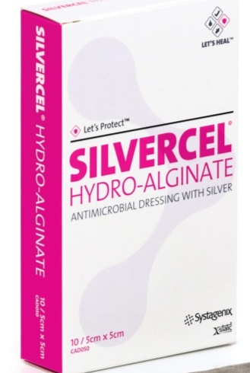
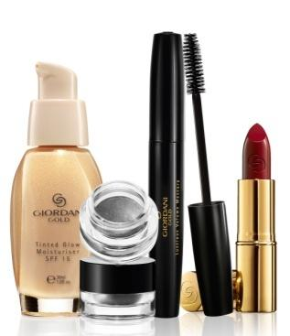
Alginate uses: The ability to go from a liquid to gel to solid by cross-linking is useful because one can control the viscosity of the final solution. It can be thick or thin. To make dental impressions, a lot of calcium ions are used to create many cross-links which will make the impression stiff. In other items like ice cream, cosmetics, and wound dressings, there
are less calcium ions, so they turn into more of a gel.

Slide 23
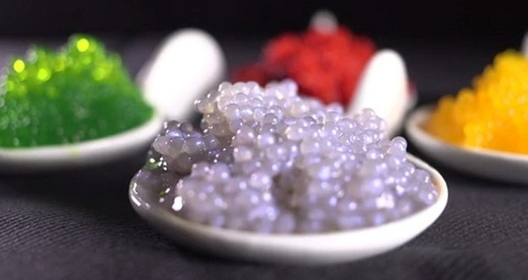
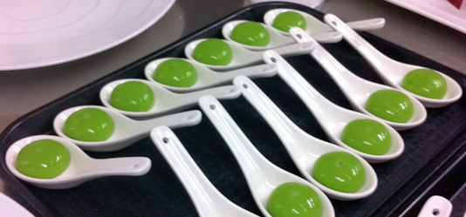
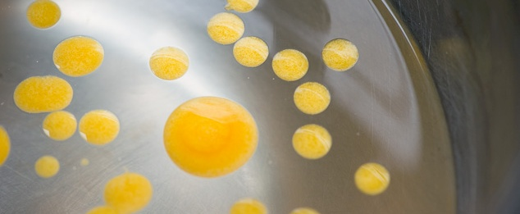
Reverse Spherification: One unique use of cross-linking sodium alginate is creating spheres of edible liquids (juices, sauces, alcoholic beverages, etc.) The technique involves adding a calcium salt such as calcium chloride, calcium lactate, or calcium lactate gluconate to the liquid one wants to be encapsulated within a sphere. That liquid is then dropped into a bowl that contains sodium alginate. When the two liquids contact each other, calcium ions in the juice cross-links the alginate in the sodium alginate solution. That creates an alginate membrane around the drop of juice. So you end up with edible liquids encased in spheres, which are used to provide bursts of flavor.

Slide 24
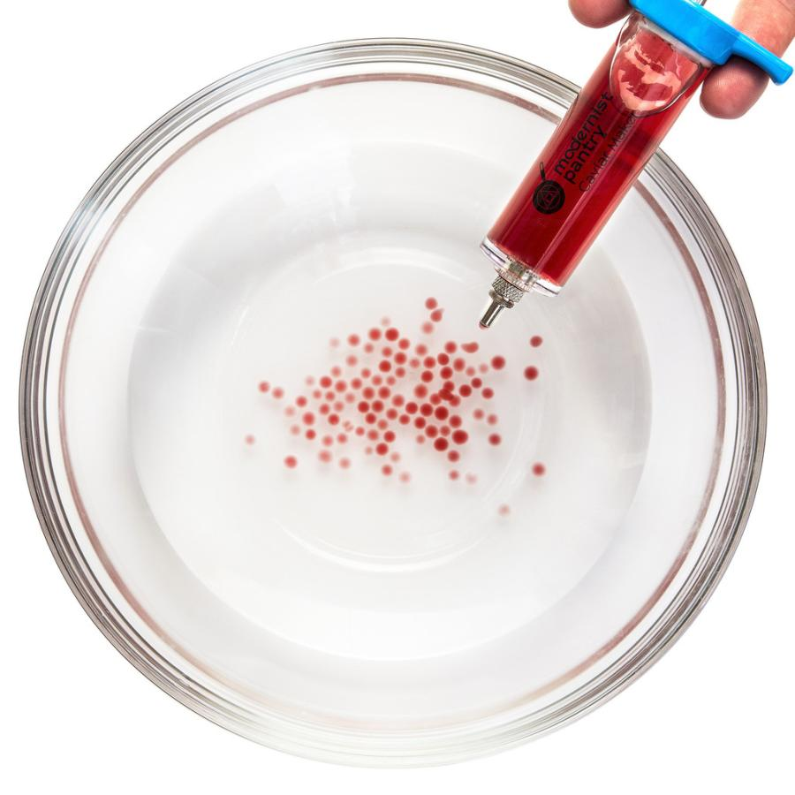
Here calcium chloride has been added to some grape juice and placed into a syringe.
In the bowl is a 0.5% w/v solution of sodium alginate.
When the drops of grape juice enter the bowl, a skin (membrane) forms around the grape juice creating spheres of grape juice.
This happens because the calcium ions cross-link the alginate chains causing them to form a non-soluble membrane around the grape juice.

Slide 25
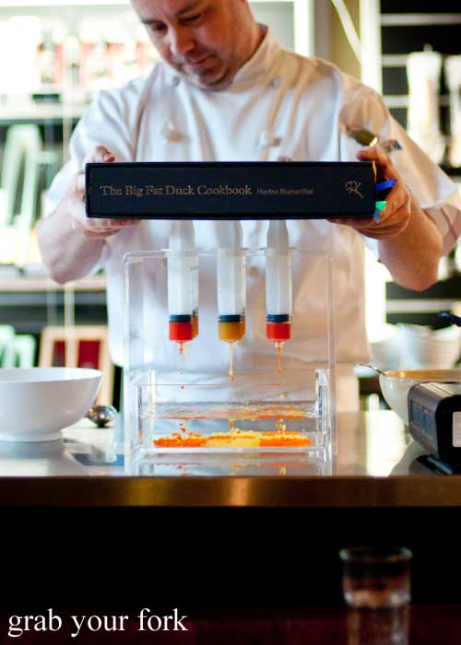
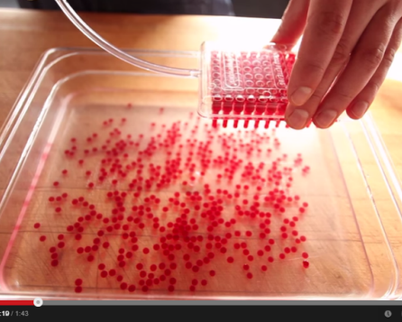
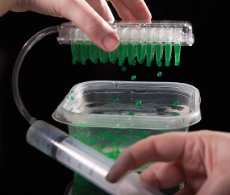

Slide 26
Molecular Gastronomy
A modern style of cooking that tries to understand the molecular level of cooking. It also tends to use more scientific equipment than regular cooking.

Slide 27
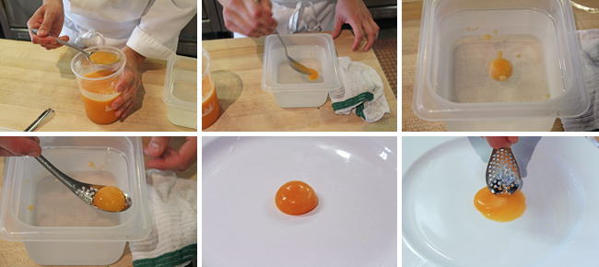
Reverse Spherification using small spoon.
https://youtu.be/A7QFcP74zyg
Using pipette to make small spheres
https://youtu.be/SJNEzawRCm8
Science lab style
https://youtu.be/Htjbu-PZ-zU

Slide 28
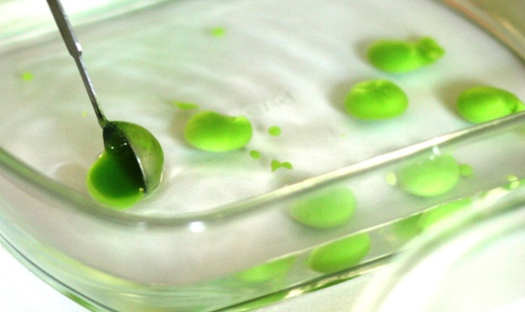
Instead of forming small spheres with a syringe, a small spoon creates larger spheres. To make the spheres more round, a thickener called xanthum gum is often added to the juice or pureed (highly blended) food. These green spheres were made from pureed peas.

Slide 29
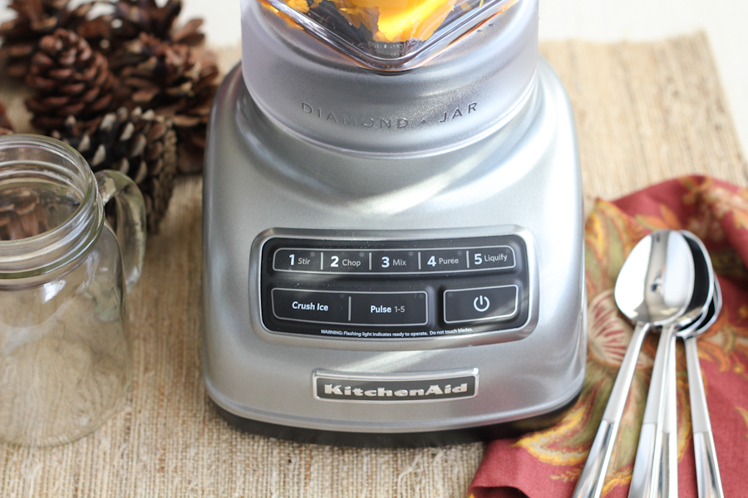

Slide 30
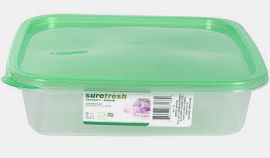
Reverse Spherification Recipe (Alginate solution): Sodium Alginate is long chains of sugar that dissolve in water. The recipe calls for a 0.5% w/v concentration of sodium alginate. “0.5% w/v” means 0.5 grams (weight) per 100 mL (volume) of solution (per 100 means %). We can make this by weighing out 0.5 grams of sodium alginate and dissolving it in 100 mL of distilled water. However, we want more than 100 mL. So we could scale it up by 4 by weighing out 2.0 grams (4 x 0.5g) of sodium alginate and dissolving that in about 400 mL (4x100mL) of distilled water. Since sodium alginate takes quite a while to dissolve, a 0.5% w/v solution has already been made for you. Place about 300 mL of the sodium alginate solution into a shallow food container.

Slide 31
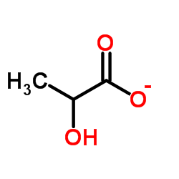
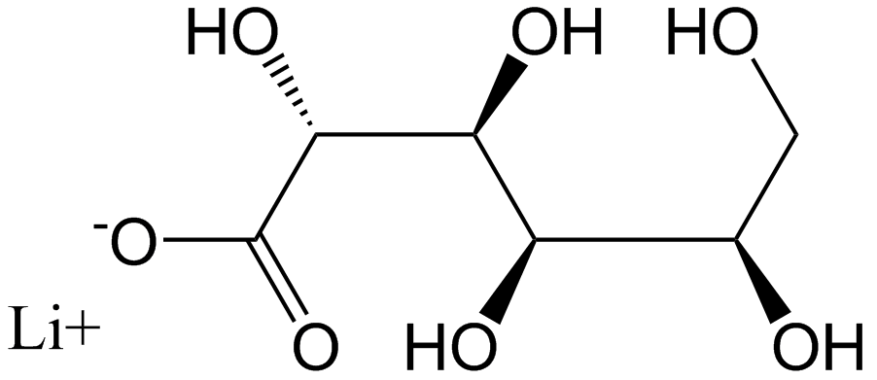
Reverse Spherification Recipe for liquid to be placed in sphere: The alginate will not form gel-like walls for the spheres unless the alginate chains are cross-linked by a metal ion with a plus 2 charge such as calcium ions (Ca²⁺). The recipe calls for the liquid we want encapsulated in a sphere to contain 2% w/w (weight to weight) concentration of calcium lactate gluconate (this has no taste but has Ca²⁺ ions). Instead of encapsulating strawberry juice, we will just use red food coloring here in the lab. It’s not a good idea to make edible products in a chemistry lab that also uses toxic materials.
Lactate
Ca²⁺
Gluconate

Slide 32
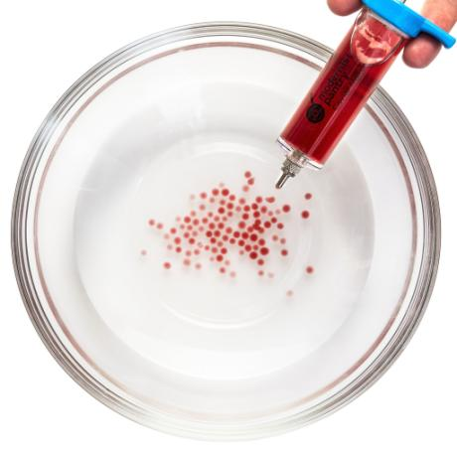
Creating spheres:
Using the syringe, try adding drops of the fake “strawberry juice” into the sodium alginate solution. Keep the drops spread out so they don’t stick to each other. Also, try placing the tip of the syringe under the surface and squeezing out larger spheres. After you get the number of spheres you want, wait 3 minutes then show them to the instructor. Then transfer them to another bowl that has tap water to rinse off the excess sodium alginate. If you leave them in the bowl with sodium alginate, the spheres could completely turn into a solid. It’s preferred that the spheres have a semi-solid skin, but the inside is a liquid.
You will repeat this procedure at home but using real juice, beverage, or sauce (like mustard or ketchup). You will be given a packet that will have the calcium lactate gluconate pre-weighed. You will also be given two bottles that contain a total of 250 mL of 0.5 % w/v sodium alginate bath solution. You will also have a new syringe and a new bottle for mixing the calcium lactate gluconate with your juice. You can also take home the shallow plastic food container if you don’t have something similar at home. See the online lab manual for details.

